Slide 1
计算机组成原理
---双语教学课件
计算机与通信学院
任学惠

Slide 2
William Stallings
Computer Organization and Architecture
6th Edition
Chapter 4
Cache Memory

Slide 3
§4.1 Characteristics
Location
Capacity
Unit of transfer
Access method
Performance
Physical type
Physical characteristics
Organisation

Slide 4
Location page97
CPU (register,cache…)
Internal (cache,main memory…)
External (disk,tape….)

Slide 5
Capacity page97
Word size （字长）
  The natural unit of organisation(字的位数)
Number of words （字数）
  or Bytes
  字(word)在不同的机器上值不同，它不是一个大家公认的单位。
  而字节是标准单位：1byte=8bit

Slide 6
Unit of Transfer 1 page97
Internal
  Usually governed by data bus width
  Be equal to the word length(or XX bits)
External
  Usually a block which is much larger than a word(e.g.4,8,16,…)
  1 block = 2^{n} words

Slide 7
Unit of Transfer 2
Addressable unit
  Smallest location which can be uniquely addressed
  Word internally
  Cluster on M$ disks
  Address code is A bits , so it can represent address from 0 to 2^{A}-1

Slide 8
Access Methods (1) page98
Sequential
  Start at the beginning and read through in order
  Access time depends on location of data and previous location
  e.g. tape
Direct
  Individual blocks have unique address
  Access is by jumping to vicinity plus sequential search
  Access time depends on location and previous location
  e.g. disk

Slide 9
Access Methods (2)
Random
  Individual addresses identify locations exactly
  Access time is independent of location or previous access
  e.g. RAM
Associative
  Data is located by a comparison with contents of a portion of the store
  Access time is independent of location or previous access
  e.g. cache

Slide 10
Memory Hierarchy page99
Registers
  In CPU
Internal or Main memory
  May include one or more levels of cache
  “RAM”
External memory
  Backing store

Slide 11

Memory Hierarchy - Diagram
速度变慢但容量加大,且单位成本降低

Slide 12
Two levels of memory
Level 1 fast but size small
Level 2 slow but size large
Access method:
-first fetches data from L1 memory if data is in (hit on)----directly gets the data—fast
-if data is not in L1 memory (hit miss), fetches data from L2 memory(certainly in) into L1 memory and into processor----slow
  H=hit on ratio (X%)
  T1=access time to L1
  T2=access time to L2

Slide 13
The average time to access the data is
T = H*T1 + (1-H)*(T1+T2)
  = T1 + (1-H)*T2
  i.g. 0.95*0.01+0.05*(0.01+0.1)=0.0095+0.0055
  =0.015
If H is near to 100%, the T near to T1
If H is near to 0%, the T near to T1+T2
(see F4.2 @page 101)

Slide 14
Performance page98
Access time
  Time between presenting the address and getting the valid data
Memory Cycle time
  Time may be required for the memory to “recover” before next access
  Cycle time is access + recovery
Transfer Rate
  Rate at which data can be moved

Slide 15
Physical Types
Semiconductor
  RAM （DRAM & SRAM)
Magnetic
  Disk & Tape
Optical
  CD & DVD
Others
  Bubble
  Hologram

Slide 16
Physical Characteristics
Decay
Volatility
Erasable
Power consumption

Slide 17
Organisation
Physical arrangement of bits into words
Not always obvious
e.g. interleaved

Slide 18
The Bottom Line
How much?
  Capacity (容量)
How fast?
  Time is money （速度）
How expensive? （成本）

Slide 19
Hierarchy List
Registers
L1 Cache
L2 Cache
Main memory
Disk cache
Disk
Optical
Tape

Slide 20
So you want fast?
It is possible to build a computer which uses only static RAM (see later)
This would be very fast
This would need no cache-结构简化
  How can you cache cache?
This would cost a very large amount

Slide 21
Locality of Reference
During the course of the execution of a program, memory references tend to cluster
e.g. loops

Slide 22

§4.2 Cache page103
Small amount of fast memory
Sits between normal main memory and CPU
May be located on CPU chip or module

Slide 23
Cache operation – overview page 105
CPU requests contents of memory location----sends an real address
Check cache for this data
If present, get from cache (fast)
If not present, read required block from main memory to cache(slow)
Then deliver from cache to CPU
Cache includes tags to identify which block of main memory is in each cache slot(line)

Slide 24
Cache Design
Size
Mapping Function
Replacement Algorithm
Write Policy
Block Size
Number of Caches

Slide 25
Size does matter
Cost
  More cache is expensive
Speed
  More cache is faster (up to a point)
  But Checking cache for data takes time

Slide 26

Typical Cache Organization

Slide 27
Mapping Function
Cache of 64kByte
Cache block of 4 bytes
  i.e. cache is 16k (2¹⁴) lines of 4 bytes
16MBytes main memory
24 bit address
  (2²⁴=16M)

Slide 28
Direct Mapping（直接映射）
Each block of main memory maps to only one （the fixed) cache line
  i.e. if a block is in cache, it must be in one specific place
Address is divided 3 parts :
  Right bits identify unique word in the block (word number :Word#)
  Middle bits specify cache’s location (line number : line #)
  Left bits serve as mark ( tag )
  Tag + line# = block number (block#)

Slide 29
Direct Mapping
Address Structure
Tag
Line #
Word #
8
14
2
24 bit address
2 bit word# (4 byte block)
22 bit block#
  14 bit line#
  8 bit tag (=24-2-14)
No two blocks in the same line have the same Tag field
Check contents of cache by finding line and checking Tag

Slide 30
Direct Mapping
Cache Line Table
Cache line Main Memory blocks held
0 0, m, 2m, 3m…2^{s}-m
1 1,m+1, 2m+1…2^{s}-m+1
m-1 m-1, 2m-1,3m-1…2^{s}-1

Slide 31
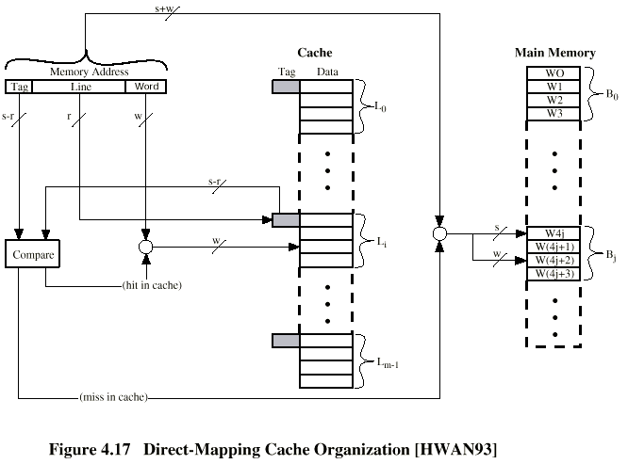
Direct Mapping Cache Organization

Slide 32
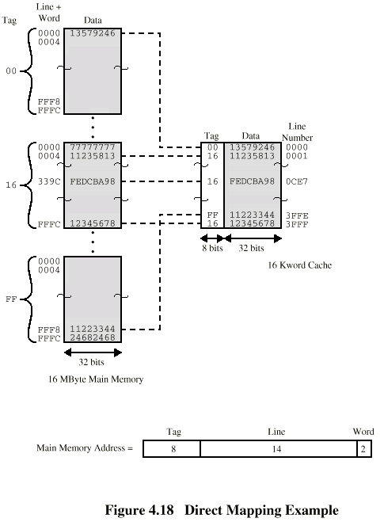
Direct Mapping Example
16K lines cache
Address 16339C H =
0001 0110 0011 0011 1001 1100
Tag(8) line#(14) word#(2)
16H 0CE7H

Slide 33
Direct Mapping Summary
Address length = n bits
Number of addressable units = 2^{n} words or bytes
Block size = line size = 2^{w} words or bytes
Number of blocks in main memory
  = 2^{n} / 2^{w} = 2^{n-w}
Number of lines in cache = 2^{r}
Size of line# = r bits
Size of tag = (n – w - r) bits

Slide 34
Direct Mapping pros & cons
Simple
Inexpensive
Fixed location for given block
  If a program accesses 2 blocks that map to the same line repeatedly, cache misses are very high

Slide 35
Associative Mapping (关联映射）
A main memory block can load into any line of cache
Memory address is interpreted as tag and word#
Tag uniquely identifies block of memory
Every line’s tag is examined for a match
Cache searching gets expensive

Slide 36

Fully Associative Cache Organization

Slide 37
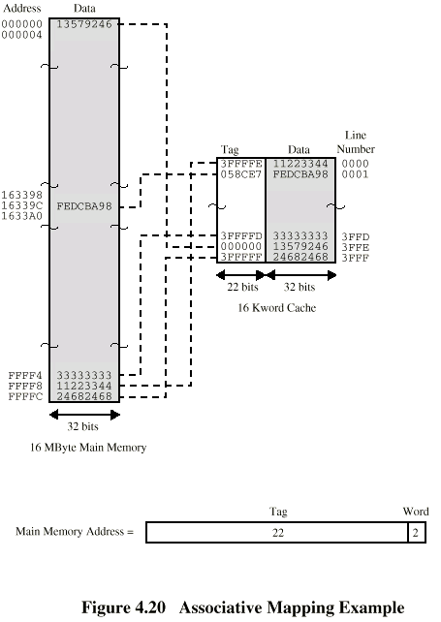
Associative Mapping Example
16K lines cache

Slide 38
Associative Mapping
Address Structure
Tag 22 bit
Word
2 bit
22 bit tag stored with each 32 bit block of data
Compare tag field with tag entry in cache to check for hit
Least significant 2 bits of address identify which 16 bit word is required from 32 bit data block
e.g.
  Address Tag Data Cache line
  FFFFFC 3FFFFF 24682468 any(3FFF)
  16339C 058CE7 FEDCBA98 any

Slide 39
Associative Mapping Summary
Address length =n=(tag bits + word#)
Number of addressable units = 2^{s+w} words or bytes
Block size = line size = 2^{w} words or bytes
Number of blocks in main memory = 2^{n} / 2^{w} = 2 ^{n-w}
Number of lines in cache = undetermined
Size of tag = n-w bits

Slide 40
Set Associative Mapping（组关联映射）
Cache is divided into a number of sets
Each set contains a number of lines
A given block maps to any line in a given (the fixed) set
  e.g. Block B can be in any line of set i
e.g. 2 lines per set
  2 way associative mapping
  A given block can be in one of 2 lines in only one set (fixed)

Slide 41
Set Associative Mapping
Example
13 bit set number( 2¹³ set & 2 way)
Block number in main memory is modulo 2¹³ ?!
000000, 00A000, 00B000, 00C000 … map to same set

Slide 42
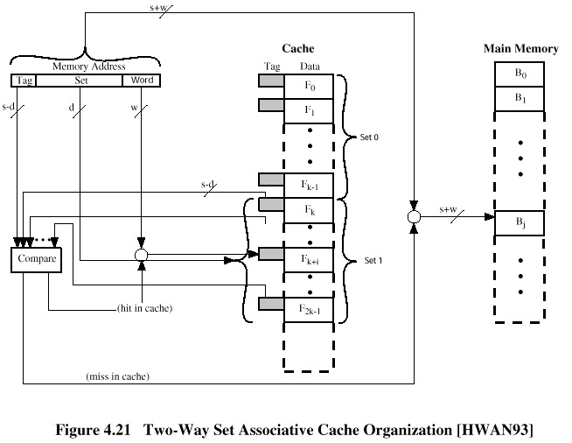
Two？K! Way Set Associative Cache Organization
?!

Slide 43
Set Associative Mapping
Address Structure
Word#
2 bit
Tag 9 bit
Set# 13 bit
Use set field to determine cache set to look in
Compare tag field to see if we have a hit
e.g
  Address Tag Data Set number
  16339C 02C FEDCBA98 0CE7
  FFFFFF 1FF 11223344 1FFF

Slide 44
Two Way Set Associative Mapping Example
16339C
16K lines cache

Slide 45
Set Associative Mapping Summary
Address length = (s + w) bits
Number of addressable units = 2^{s+w} words or bytes
Block size = line size = 2^{w} words or bytes
Number of blocks in main memory = 2^{d}
Number of lines in set = k
Number of sets = v = 2^{d}
Number of lines in cache = kv = k * 2^{d}
Size of tag = (s – d) bits

Slide 46
Replacement Algorithms (1)
Direct mapping page115
When a new block is brought into the cache , one of the existing block must be replaced. Which one ?
No choice
Each block only maps to one line
  ---- a Fixed line
Replace that line

Slide 47
Replacement Algorithms (2)
Associative & Set Associative
Hardware implemented algorithm (speed)
Least Recently used (LRU) *problem4.8&4.11
e.g. in 2 way set associative
  Which of the 2 block is lru?
Each line includes a USE bit. When a line is referenced , its USE bit is set to 1 and the USE bit of the other line in same set is set to 0.
So , the USE bit is 0 , meaning the line is LRU, replacement is occurred in the line.

Slide 48
Replacement Algorithms (3)
Associative & Set Associative
First in first out (FIFO)
  replace block that has been in cache longest
  Using a counter to record history
Least frequently used
  replace block which has had fewest hits
  Using a counter to record frequency
Random

Slide 49
Write Policy page118
Must not overwrite a main memory unless cache block is up to date
Multiple CPUs may have individual caches
I/O may address main memory directly

Slide 50
Write through
All writes go to main memory as well as cache
The data in a cache line is changed (writed) , the change must occur in memory block at the same time.
Multiple CPUs can monitor main memory traffic to keep local (to CPU) cache up to date
Lots of traffic
Slows down writes
Remember bogus write through caches!
假的

Slide 51
Write back
Updates initially made in cache only
Update bit for cache line is set when update occurs
If block is to be replaced, write to main memory only if update bit is set
Other caches get out of sync
I/O must access main memory through cache
N.B. 15% of memory references are writes

Slide 52
Line size page 119
Simply , a large block size(same as line size), may rise the HIT IN ratio .
But heavy traffic to BUS and ……

Slide 53
Number of caches page 119
Multi-level caches
  On chip cache , on board cache , ……
  CPU , L1 cache , L2 cache , memory
  1 : 1——2 : 10 : 50 ——100
Unified cache or split caches
  On-chip cache holds data & instructions
  Unified cache, dynamic adjust the size of data or instructoins by HIT ON ratio
  Split cache :data writes back memory, but instructions does not …..

Slide 54
Pentium 4 Cache
80386 – no on chip cache
80486 – 8k using 16 byte lines and four way set associative organization
Pentium (all versions) – two(split) on chip L1 caches
  Data & instructions

Slide 55
Pentium 4 – L1 caches
  8k bytes
  64 byte lines
  four way set associative
L2 cache
  Feeding both L1 caches
  256k
  128 byte lines
  8 way set associative

Slide 56
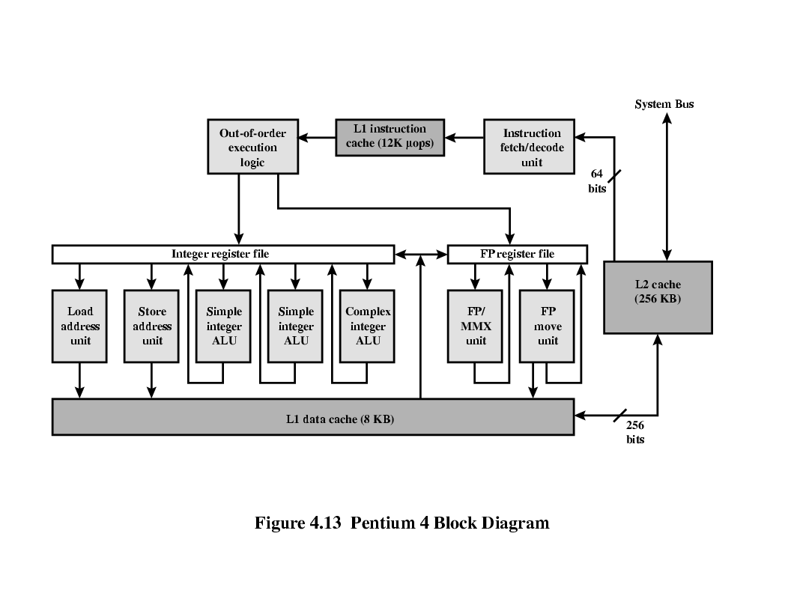
Pentium 4 Diagram (Simplified)
NOW，UPTO
32MB
2MB

Slide 57
Pentium 4 Core Processor
Fetch/Decode Unit
  Fetches instructions from L2 cache
  Decode into micro-ops
  Store micro-ops in L1 cache
Out of order execution logic
  Schedules micro-ops
  Based on data dependence and resources
  May speculatively execute

Slide 58
Execution units
  Execute micro-ops
  Data from L1 cache
  Results in registers
Memory subsystem
  L2 cache and systems bus

Slide 59
Pentium 4 Design Reasoning
Decodes instructions into RISC like micro-ops before L1 cache
Micro-ops fixed length
  Superscalar pipelining and scheduling
Pentium instructions long & complex
Performance improved by separating decoding from scheduling & pipelining
  (More later – ch14)
Data cache is write back
  Can be configured to write through
L1 cache controlled by 2 bits in register
  CD = cache disable
  NW = not write through
  2 instructions to invalidate (flush) cache and write back then invalidate

Slide 60
Power PC Cache Organization
601 – single 32kb 8 way set associative
603 – 16kb (2 x 8kb) two way set associative
604 – 32kb
610 – 64kb
G3 & G4
  64kb L1 cache
    8 way set associative
  256k, 512k or 1M L2 cache
    two way set associative

Slide 61
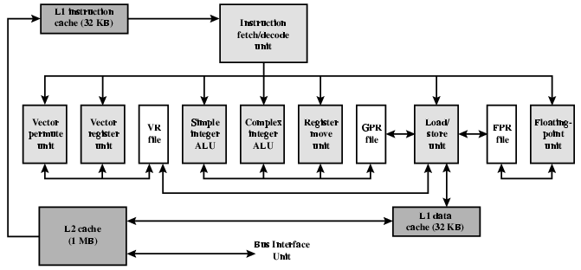
PowerPC G4

Slide 62
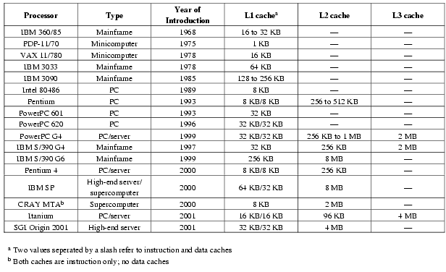
Comparison of Cache Sizes

Slide 63
Pentium 4 Cache
80386 – no on chip cache
80486 – 8k using 16 byte lines and four way set associative organization
Pentium (all versions) – two on chip L1 caches
  Data & instructions
Pentium III – L3 cache added off chip
Pentium 4
  L1 caches
    8k bytes
    64 byte lines
    four way set associative
  L2 cache
    Feeding both L1 caches
    256k
    128 byte lines
    8 way set associative
  L3 cache on chip

Slide 64
Intel Cache Evolution
Problem
Solution
Processor on which feature first appears
External memory slower than the system bus.
Add external cache using faster memory technology.
386
Increased processor speed results in external bus becoming a bottleneck for cache access.
Move external cache on-chip, operating at the same speed as the processor.
486
Internal cache is rather small, due to limited space on chip
Add external L2 cache using faster technology than main memory
486
Contention occurs when both the Instruction Prefetcher and the Execution Unit simultaneously require access to the cache. In that case, the Prefetcher is stalled while the Execution Unit’s data access takes place.
Create separate data and instruction caches.
Pentium
Increased processor speed results in external bus becoming a bottleneck for L2 cache access.
Create separate back-side bus that runs at higher speed than the main (front-side) external bus. The BSB is dedicated to the L2 cache.
Pentium Pro
Move L2 cache on to the processor chip.
Pentium II
Some applications deal with massive databases and must have rapid access to large amounts of data. The on-chip caches are too small.
Add external L3 cache.
Pentium III
Move L3 cache on-chip.
Pentium 4

Slide 65
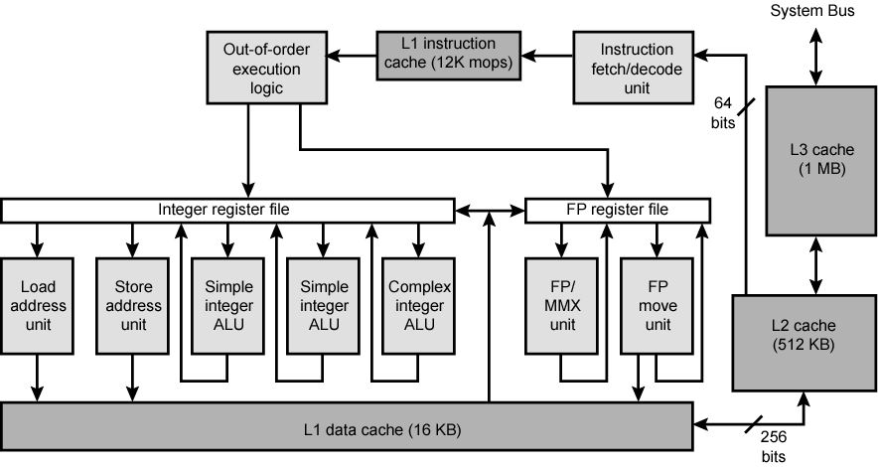
Pentium 4 Block Diagram

Slide 66
Pentium 4 Core Processor
Fetch/Decode Unit
  Fetches instructions from L2 cache
  Decode into micro-ops
  Store micro-ops in L1 cache
Out of order execution logic
  Schedules micro-ops
  Based on data dependence and resources
  May speculatively execute
Execution units
  Execute micro-ops
  Data from L1 cache
  Results in registers
Memory subsystem
  L2 cache and systems bus

Slide 67
Pentium 4 Design Reasoning
Decodes instructions into RISC like micro-ops before L1 cache
Micro-ops fixed length
  Superscalar pipelining and scheduling
Pentium instructions long & complex
Performance improved by separating decoding from scheduling & pipelining
  (More later – ch14)
Data cache is write back
  Can be configured to write through
L1 cache controlled by 2 bits in register
  CD = cache disable
  NW = not write through
  2 instructions to invalidate (flush) cache and write back then invalidate
L2 and L3 8-way set-associative
  Line size 128 bytes

Slide 68
PowerPC Cache Organization
601 – single 32kb 8 way set associative
603 – 16kb (2 x 8kb) two way set associative
604 – 32kb
620 – 64kb
G3 & G4
  64kb L1 cache
    8 way set associative
  256k, 512k or 1M L2 cache
    two way set associative
G5
  32kB instruction cache
  64kB data cache

Slide 69
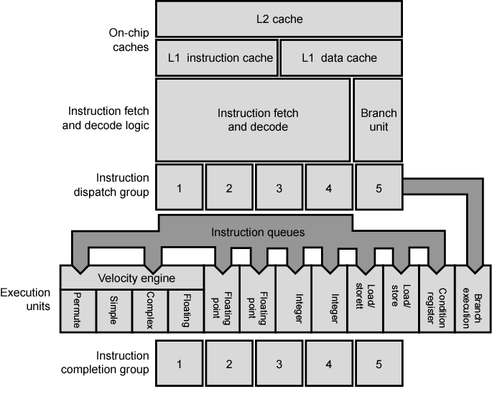
PowerPC G5 Block Diagram

Slide 70


Thank you for
your listening !

